Slide 1
Website Project Fifa
Group 1

Slide 2
Inleiding
Moscow C-Sharp
Home
Schedule
Standings
Login menu
Admin menu
Live demo

Slide 3
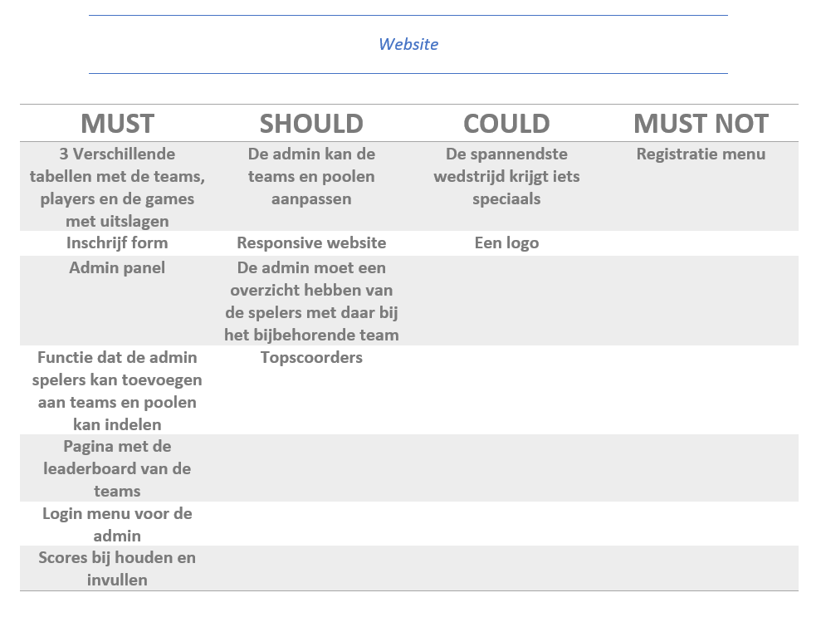
MoSCoW

Slide 4
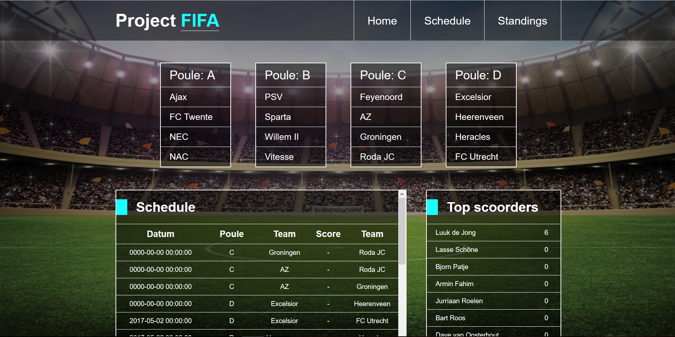
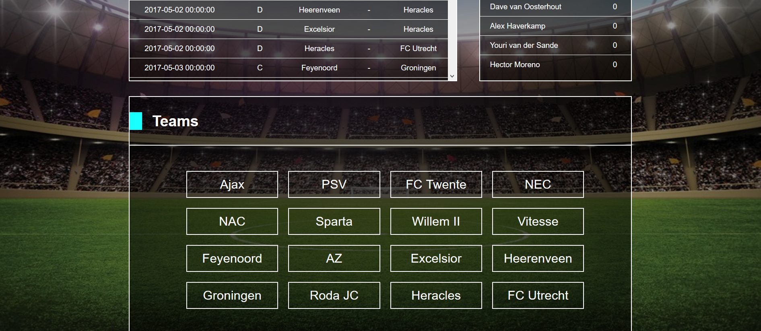
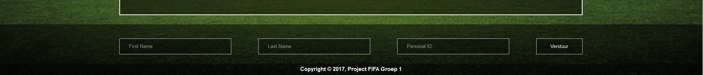
Home
Poules met teams
Schedule
Top scoorders
Teams met spelers
Inschrijf form

Slide 5
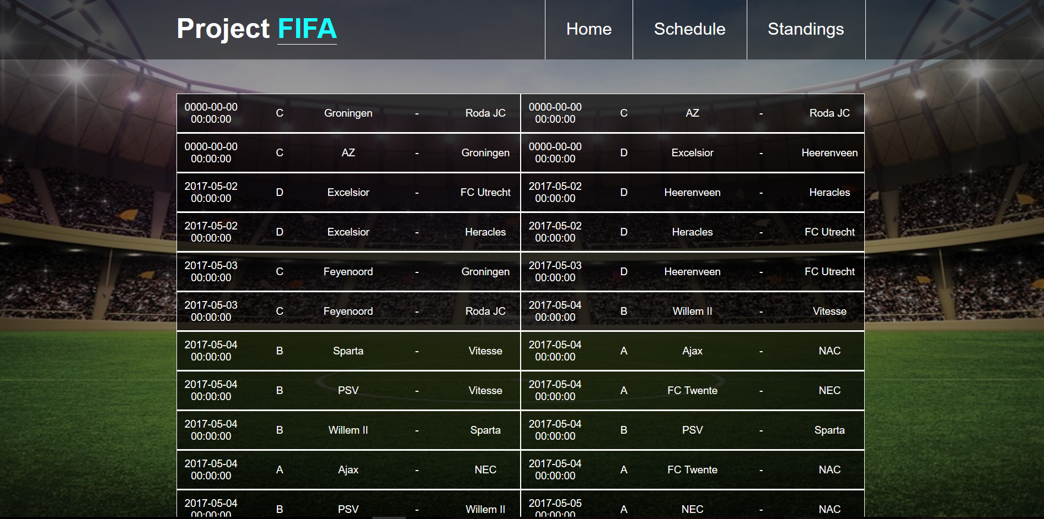
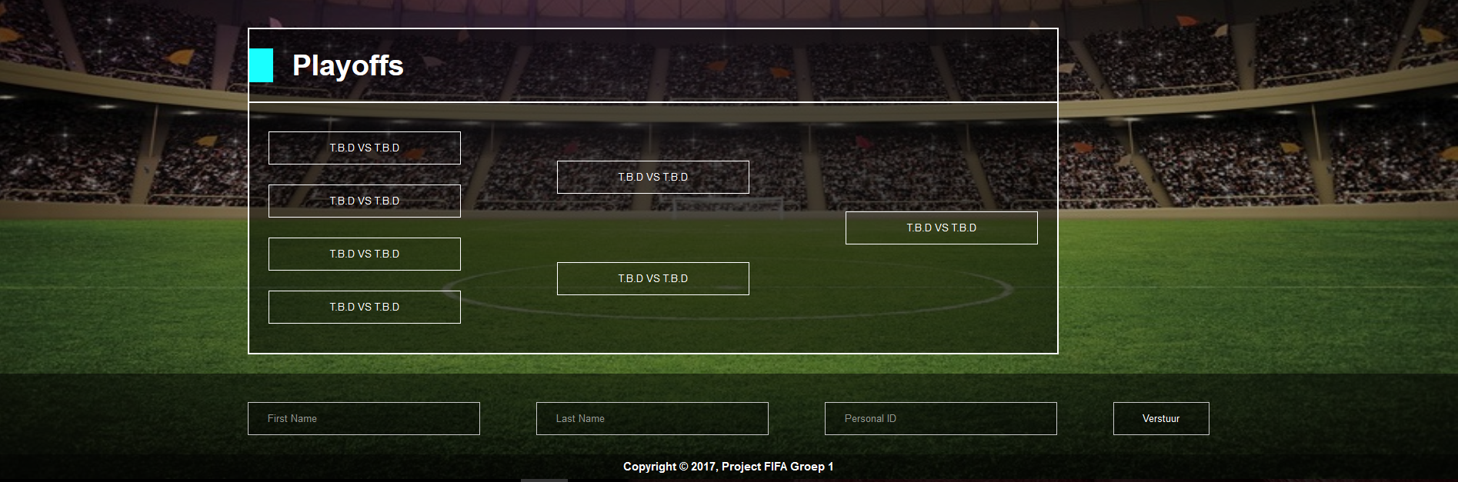
Schedule
Poule fase
Playoffs
Inschrijf form

Slide 6
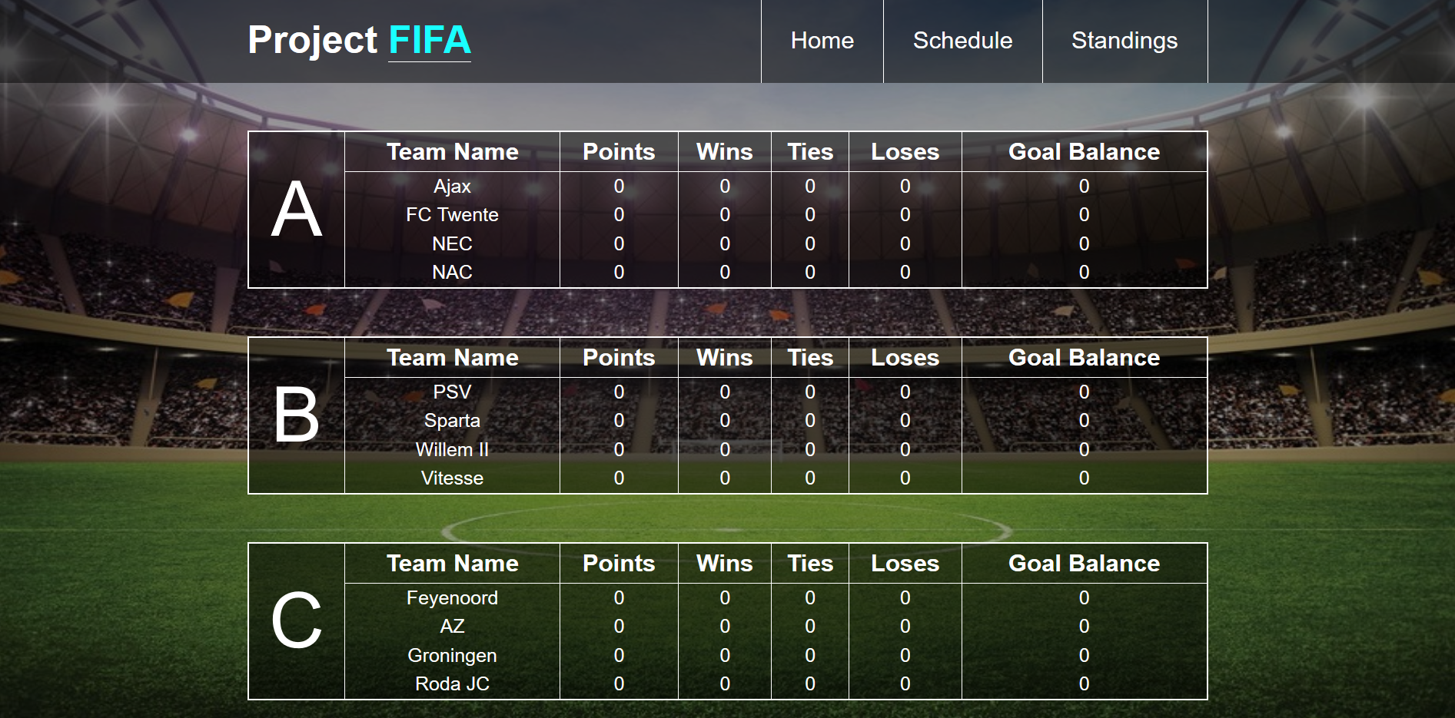
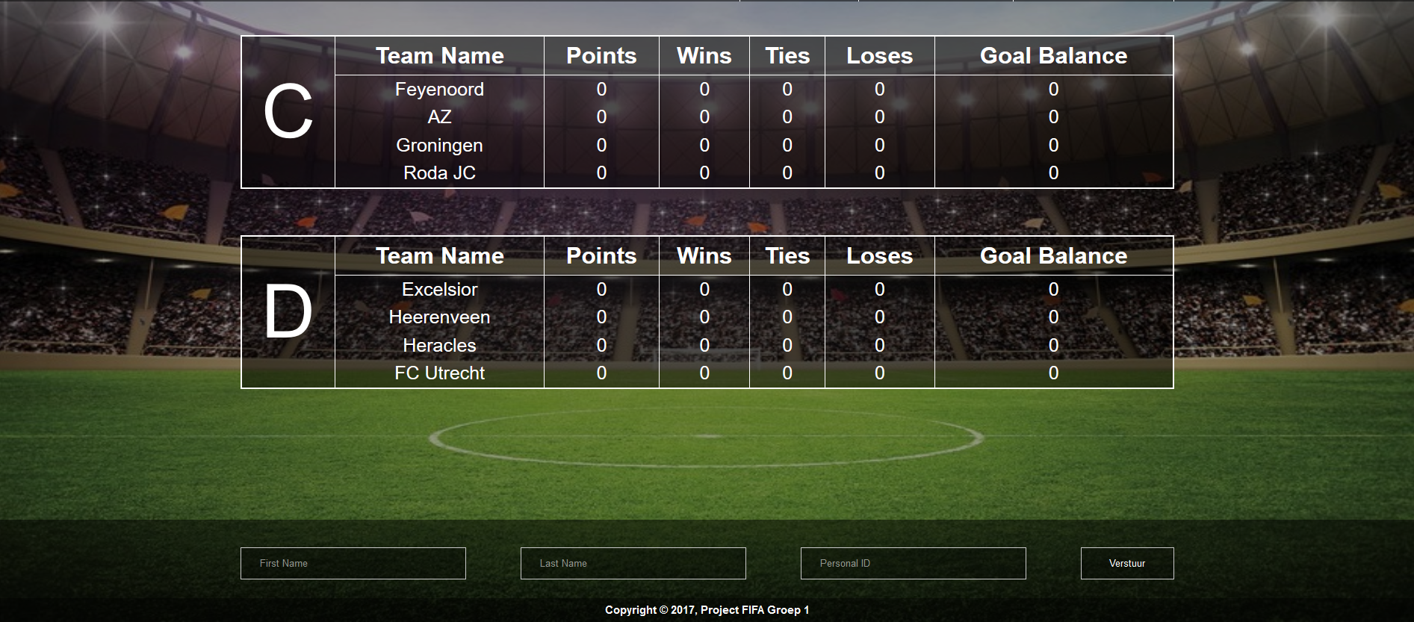
Standings
Standings
Inschrijf form

Slide 7
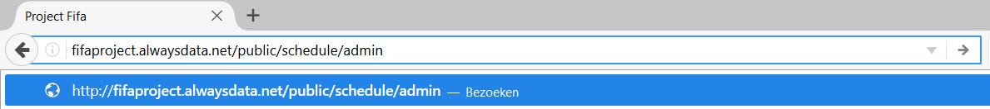
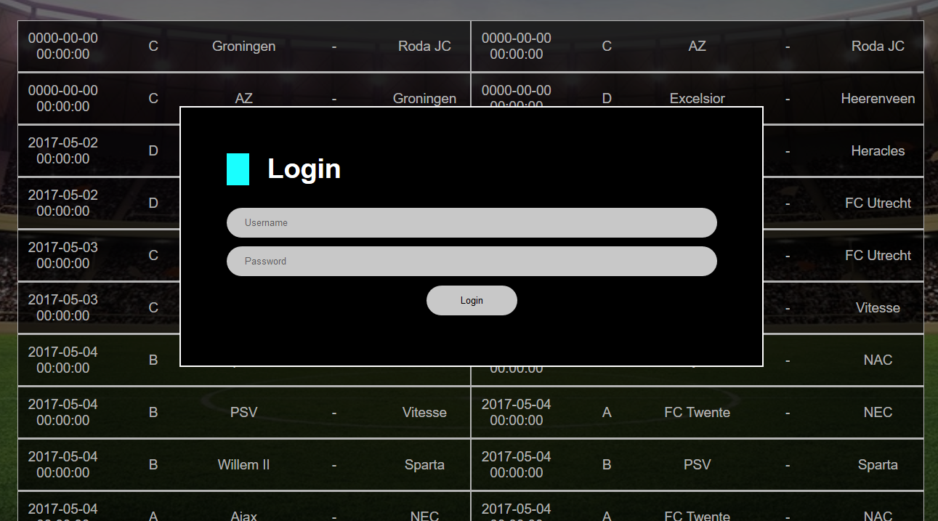
Login Menu
/admin

Slide 8
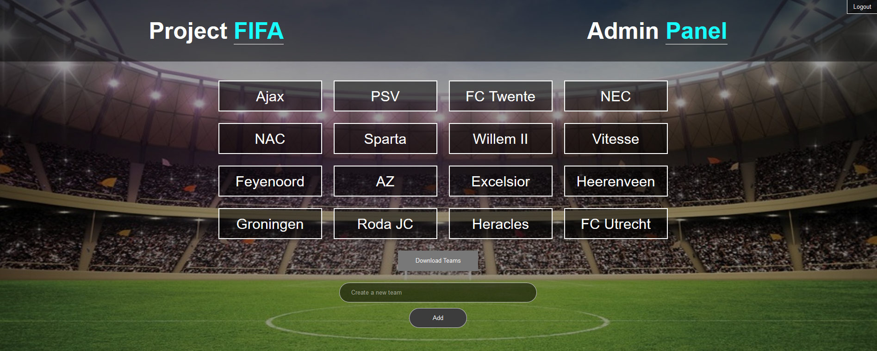
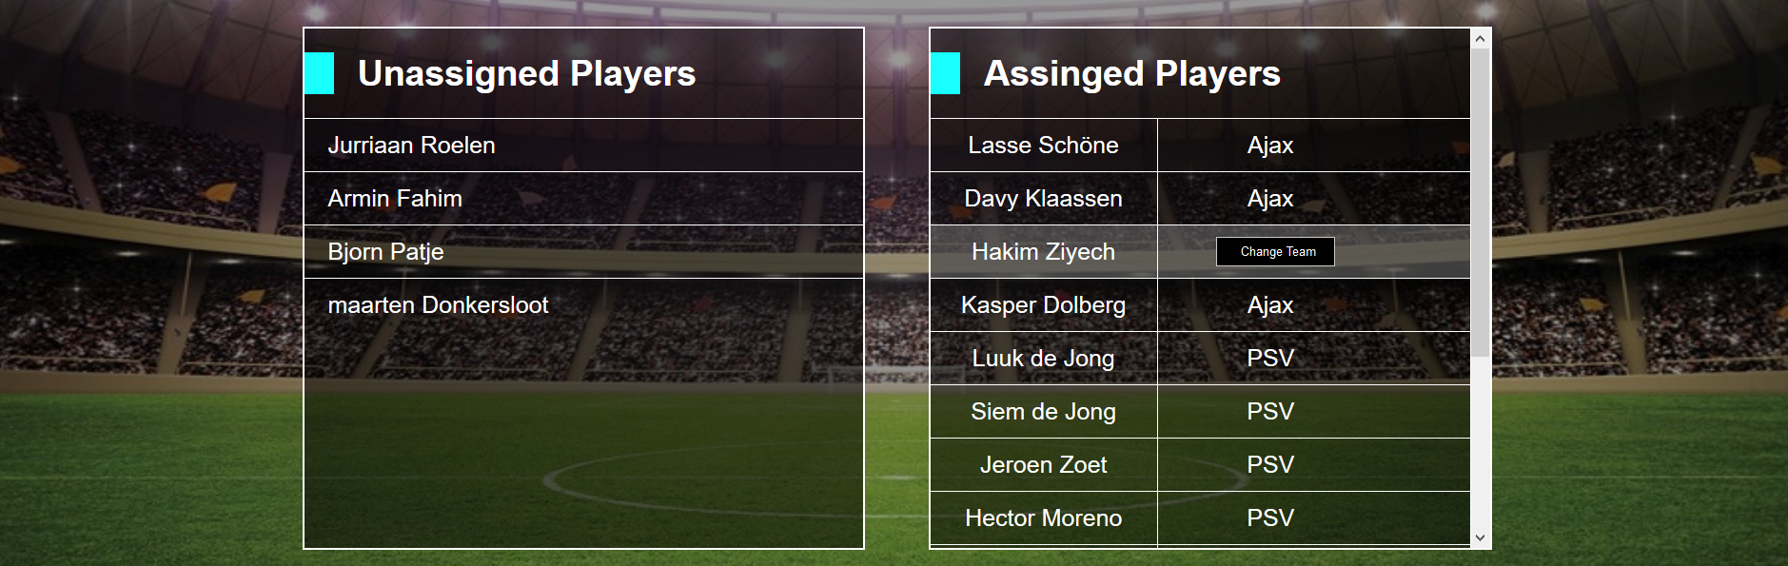
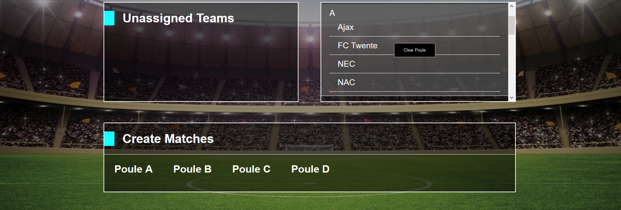
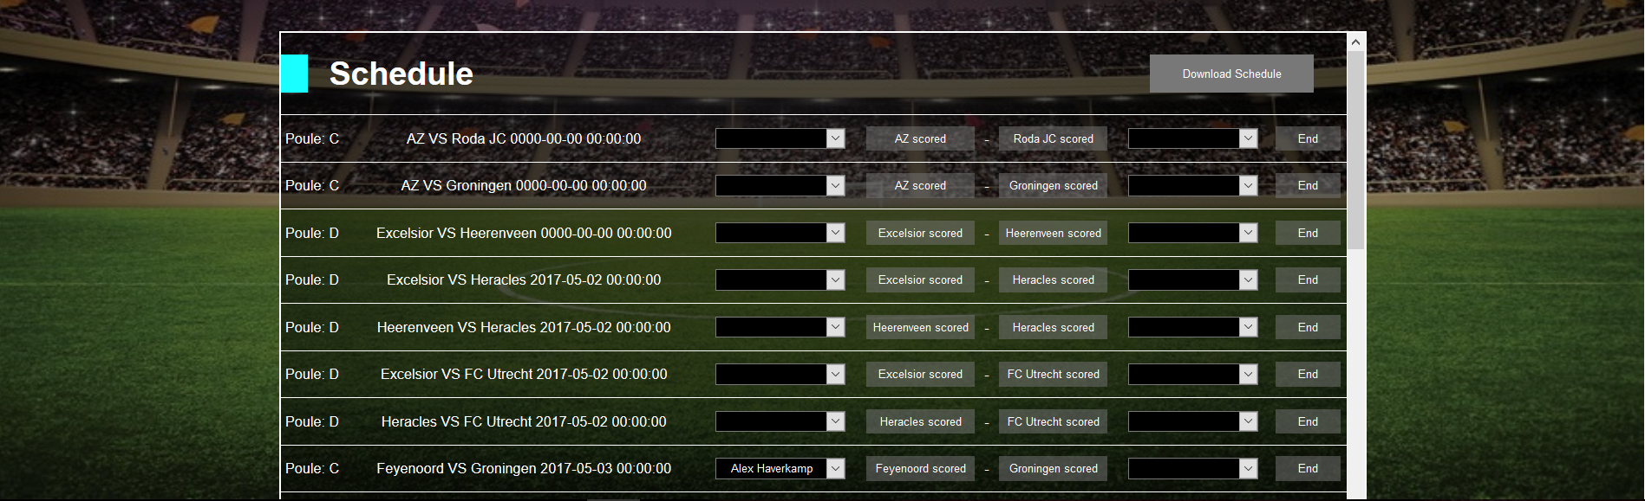
Admin Menu
Create teams
Asign players/unasign players
Asign teams/unasign teams
Create match
Manage scores poule phase
Manage scores playoffs
Start playoffs

